Slide 1

Machine Learning Project
Under the guidance of ‘Prof. Tanmay Chakraborty’, Teaching Fellow ‘Chhavi Mam’ and Teaching Assistant ‘Nirav Sir’.
Members:
Rishabh Bafna (MT20118)
Vandana Sharma (MT20106)
Chetan Sharaf (MT20109)

Slide 2
Fake Job Posting Detection
Objective: Predicting whether the jobs are real or fake on the basis of a suitable model and extracting information from the given dataset, i.e., getting insights from the given dataset.

Slide 3
Motive: Now-a-days, there are a lot of job scams because of unemployment. There are a lot of websites which connect recruiter to a suitable candidate. Sometimes, fake recruiters post a job posting on the job portal with a motive to get money.
This problems occurs with many job portals. Later, people shift to a new job portal in search of real job but the fake recruiters join this portal as well.

Slide 4
Dataset: The dataset has been taken from Kaggle.
[Real or Fake] Fake JobPosting Prediction
Dataset of real and fake job postings
Attributes:
1. job_id
2. title
3. location
4. department
5. salary_range
6. company_profile
7. description
8. requirements
9. benefits
10. telecommunicating
11. has_company_logo
12. has_questions
13. employment_type
14. required_experience
15. required_education
16. industry
17. function
18. fraudulent

Slide 5
The dataset contains a lot of text description. Hence, we can say that the project is related to Natural Language Processing.
As a human, if we have to judge whether the job posting is real or fake, we would most probably go through the description and other related text.
Similarly, the machine needs to process the text in order to predict whether the job posting is real or fake.

Slide 6



Slide 7

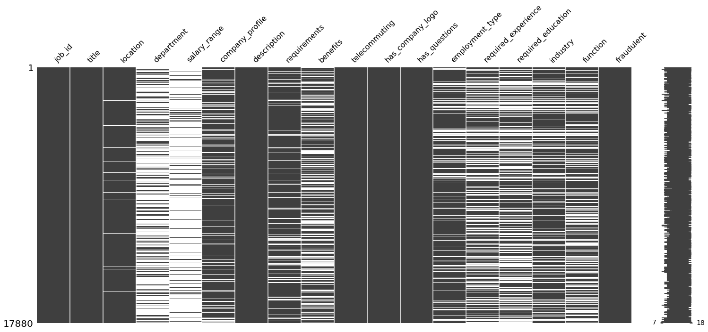
Missing Number

Slide 8
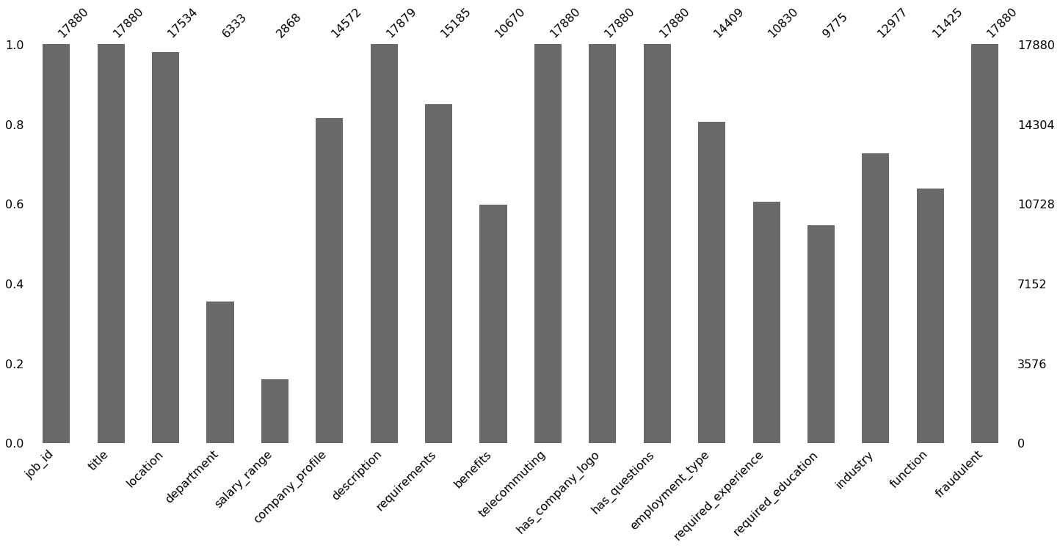

Slide 9
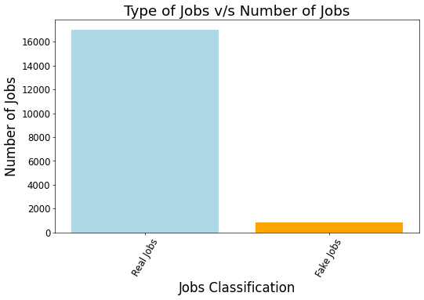

Slide 10
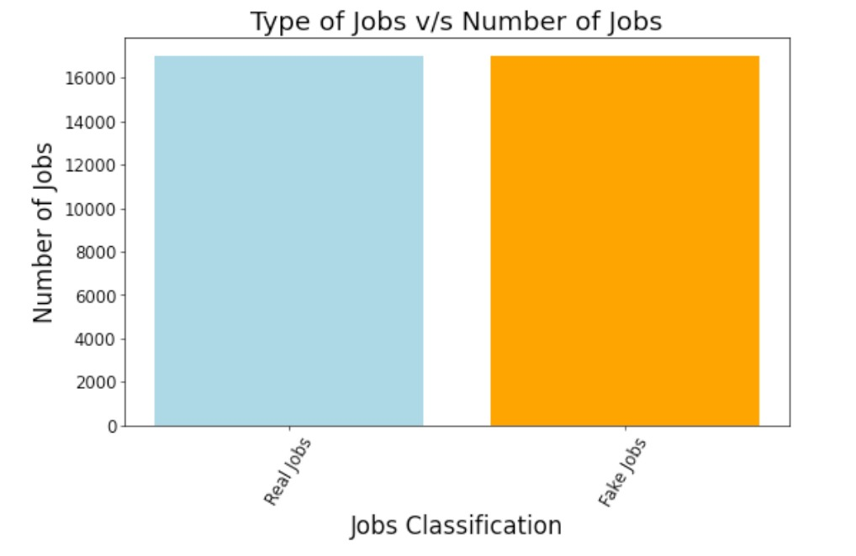
AFTER OVER SAMPLING

Slide 11
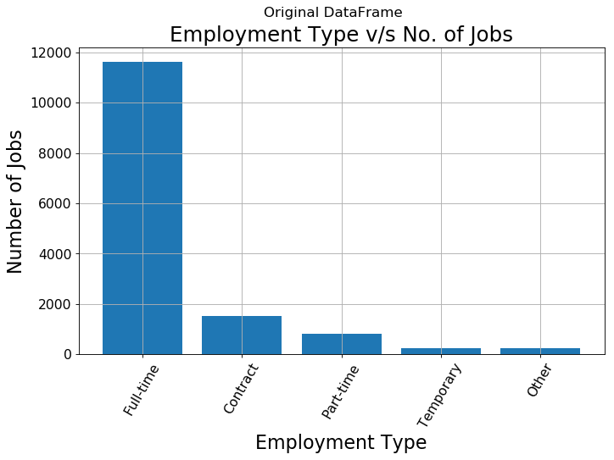

Slide 12
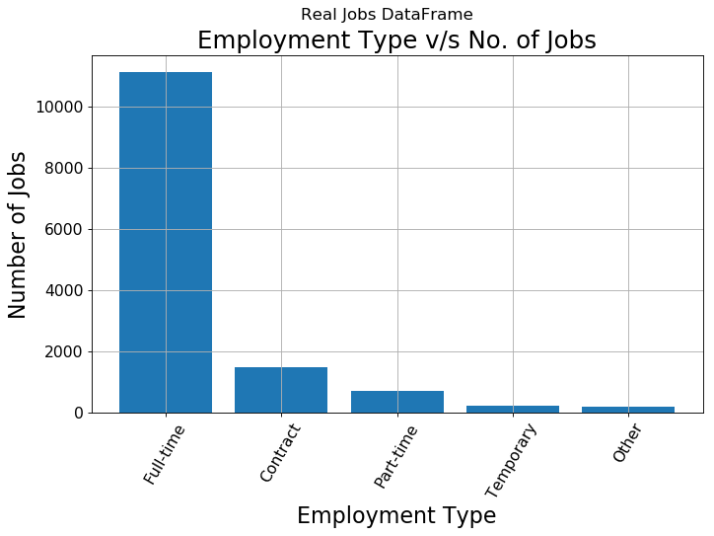

Slide 13
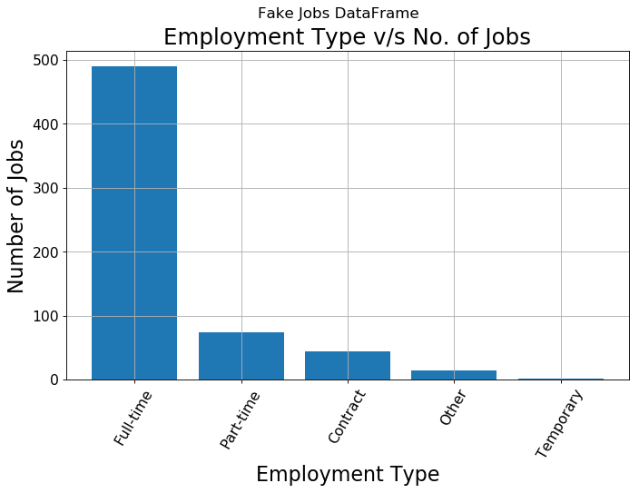

Slide 14
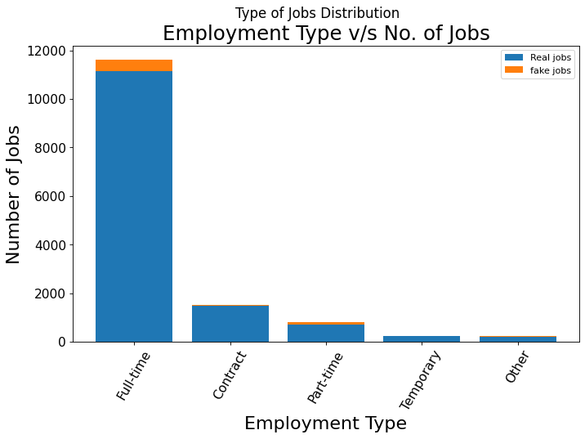

Slide 15
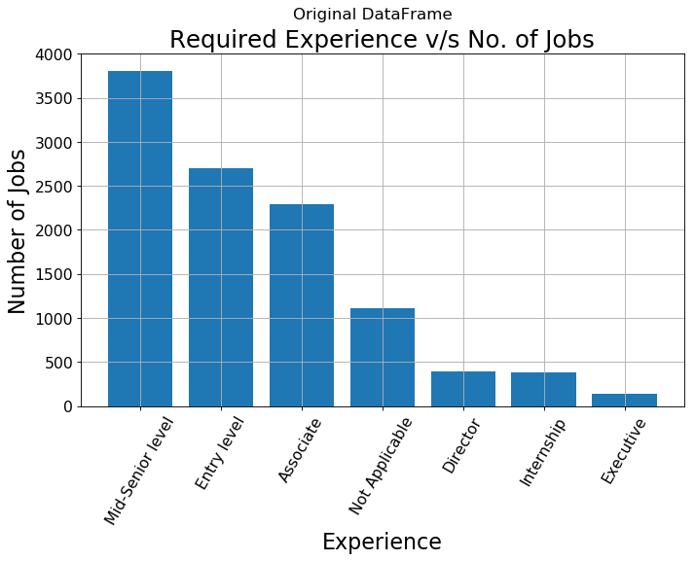

Slide 16
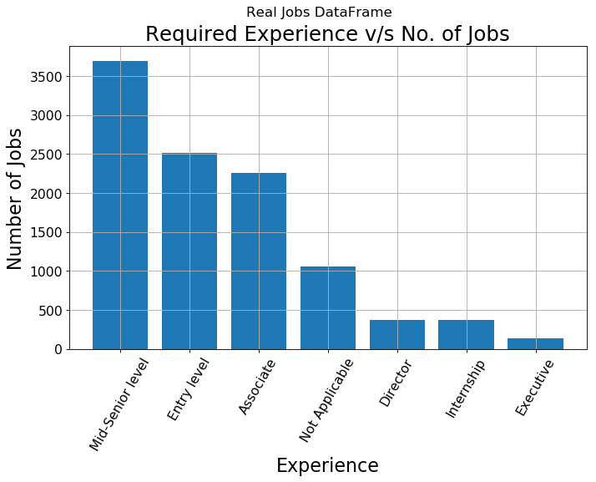

Slide 17
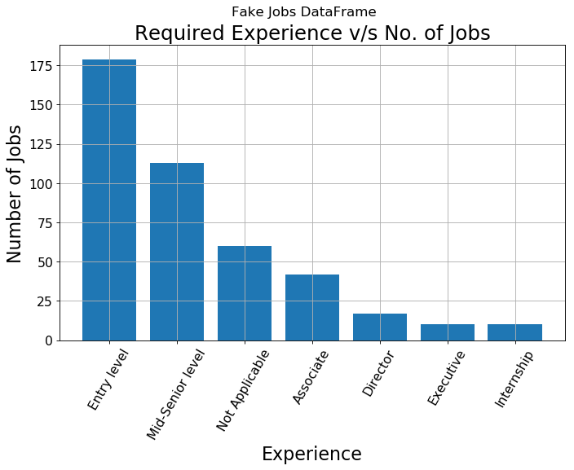

Slide 18
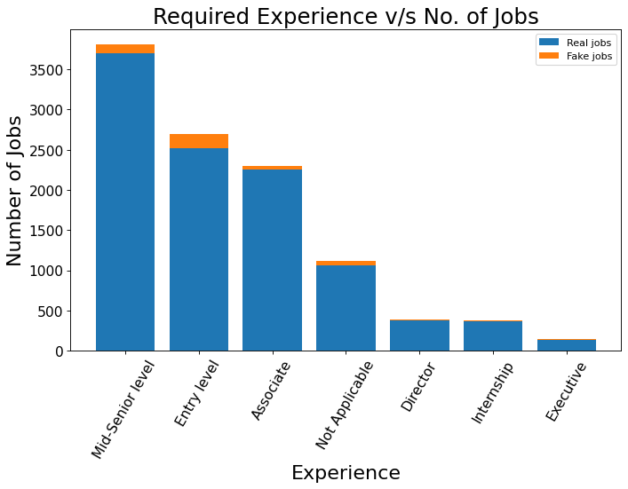

Slide 19
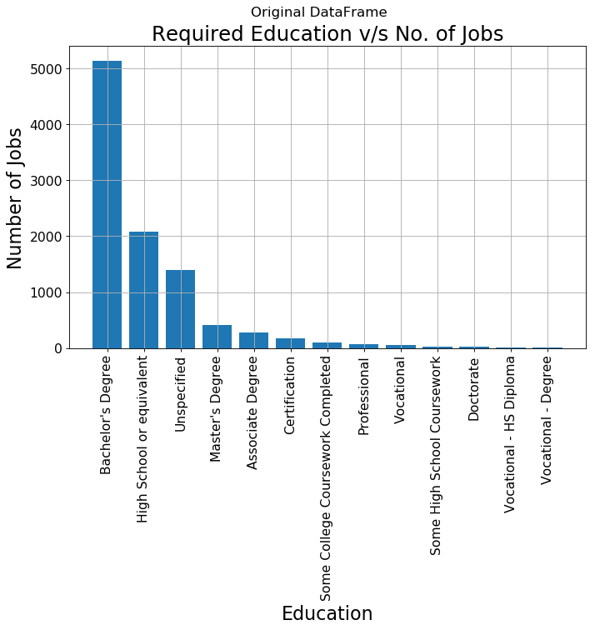

Slide 20
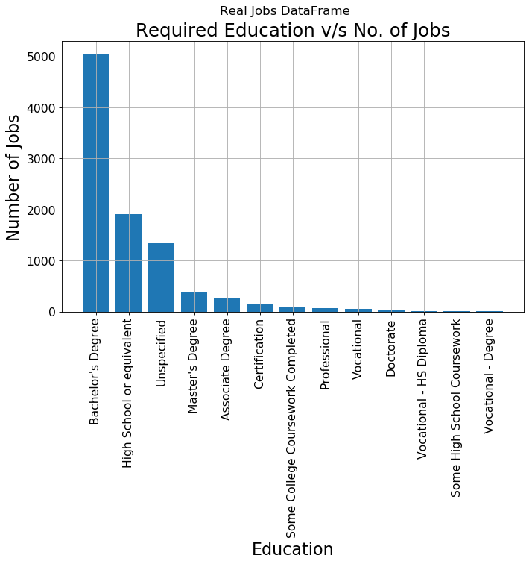

Slide 21
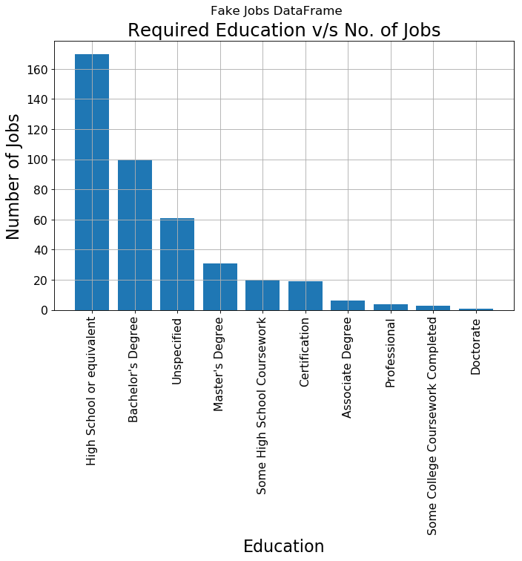

Slide 22
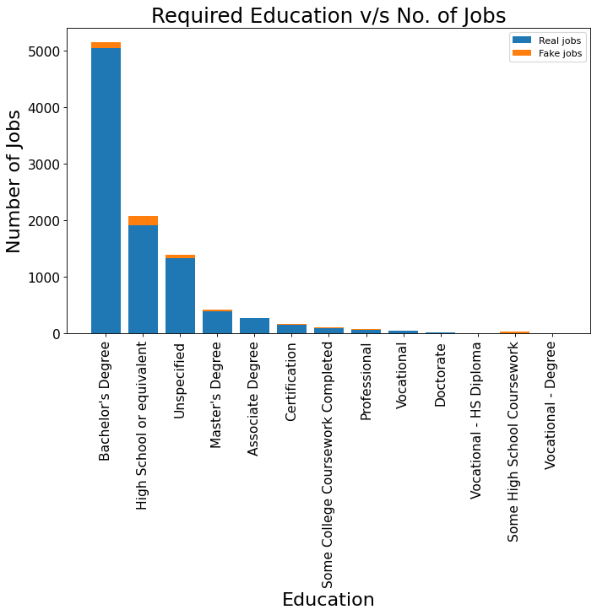

Slide 23
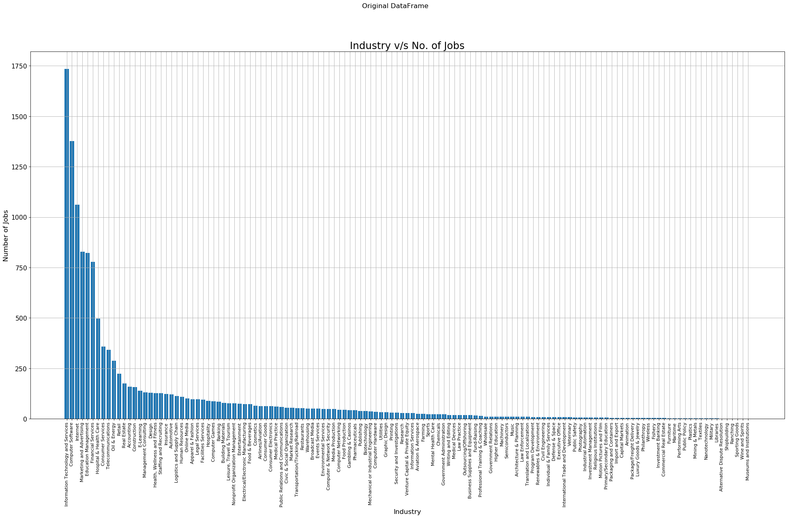

Slide 24


Slide 25
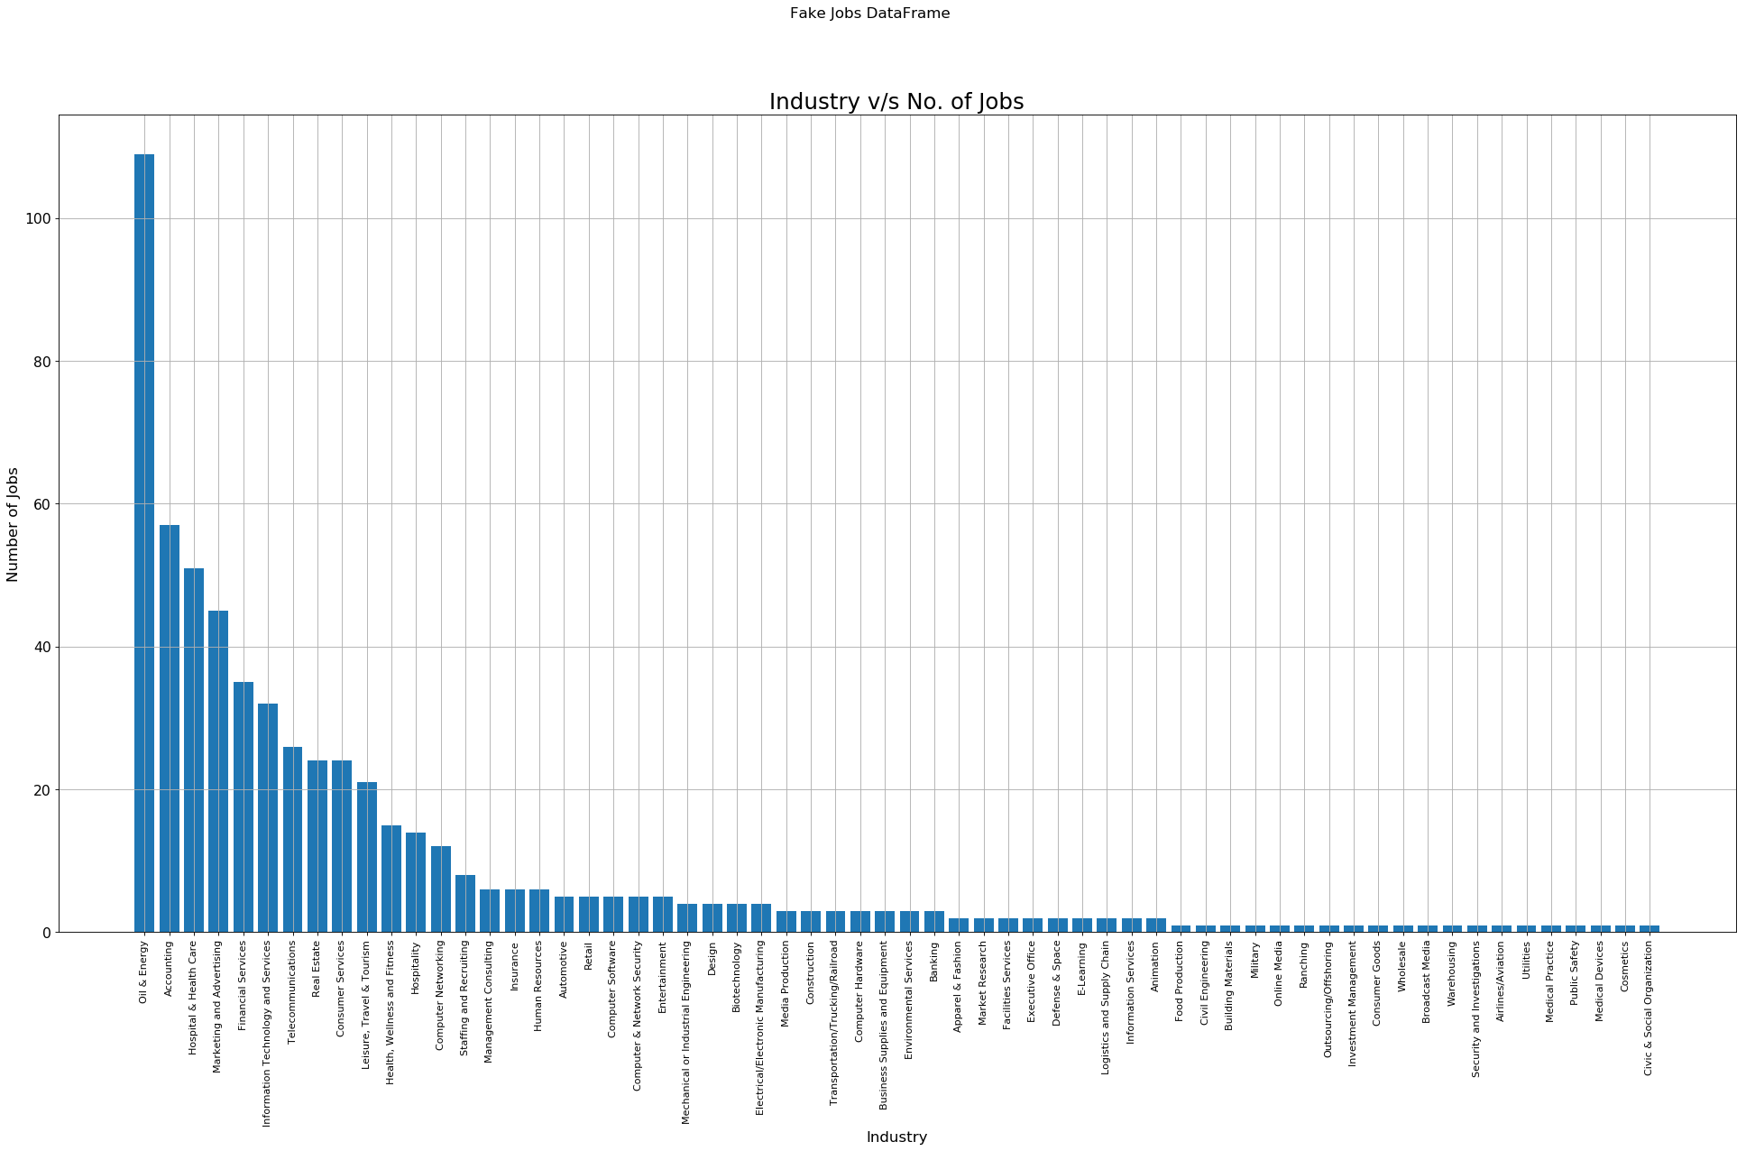

Slide 26
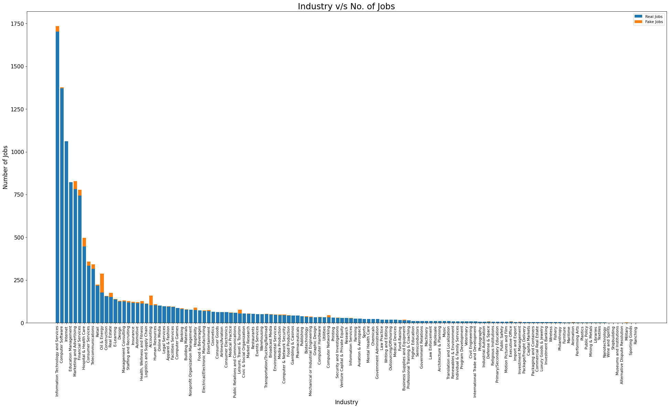

Slide 27
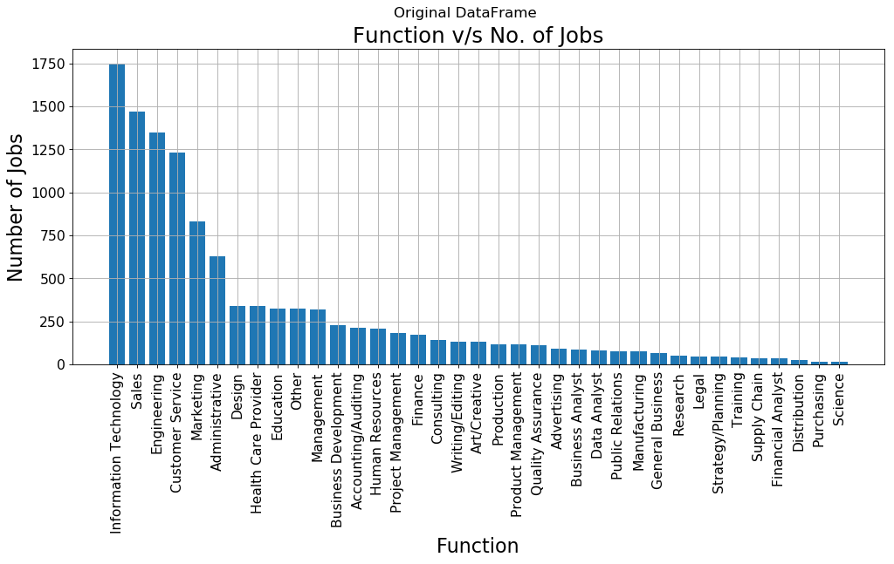

Slide 28
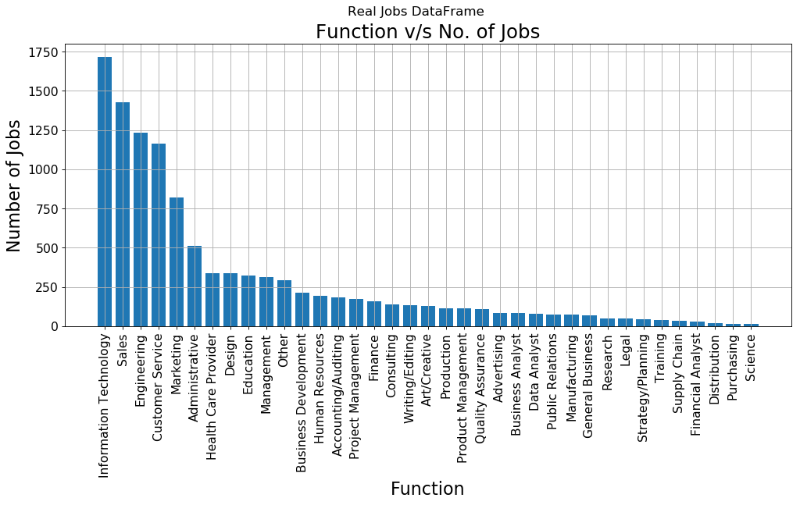

Slide 29
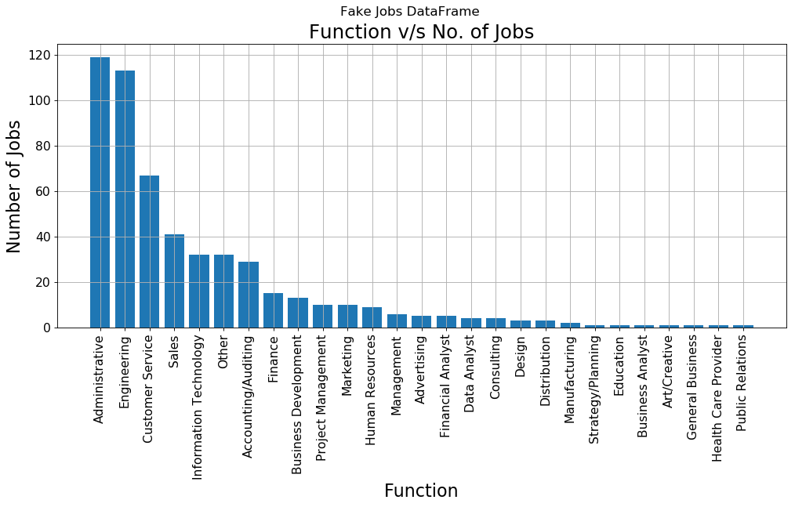

Slide 30
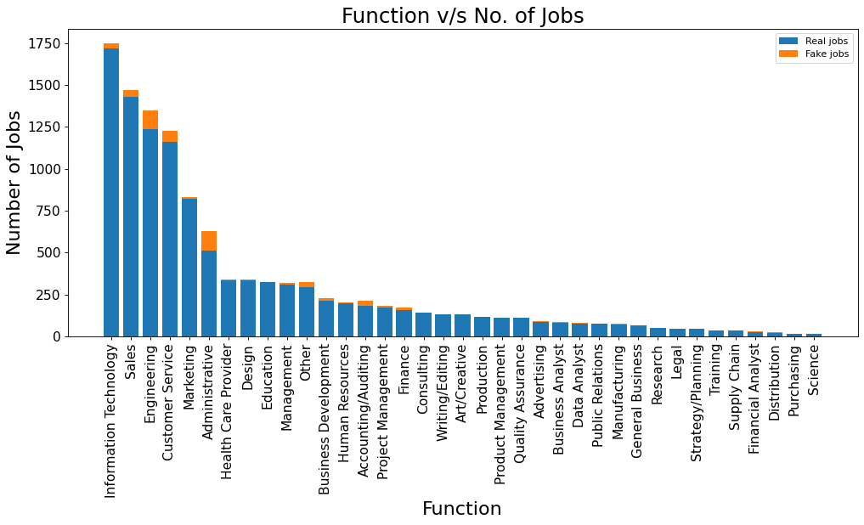

Slide 31
Let us see the word frequency of the text of Original DataFrame, Real Jobs DataFrame, and Fake Jobs DataFrame respectively through some interesting images.

Slide 32
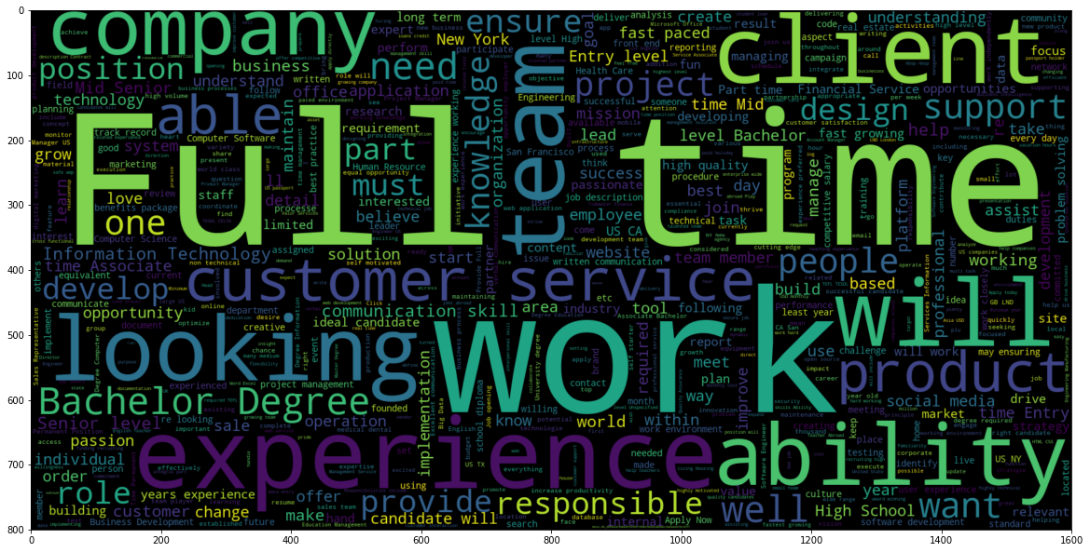
Original DataFrame Words

Slide 33
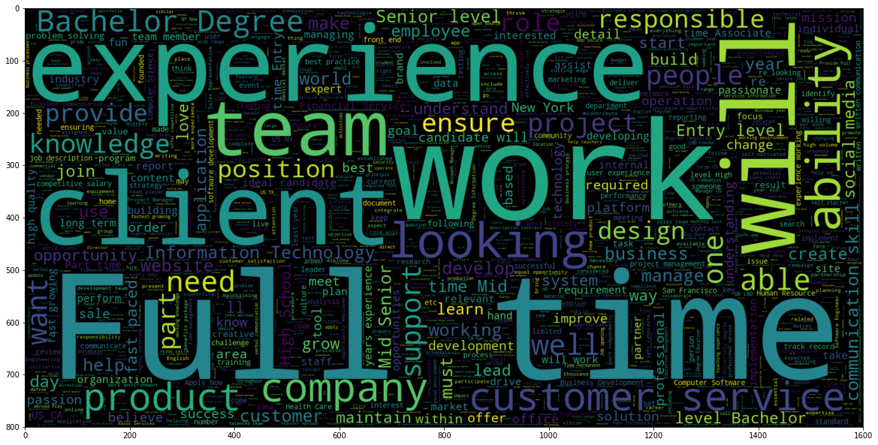
Real Jobs DataFrame Words

Slide 34
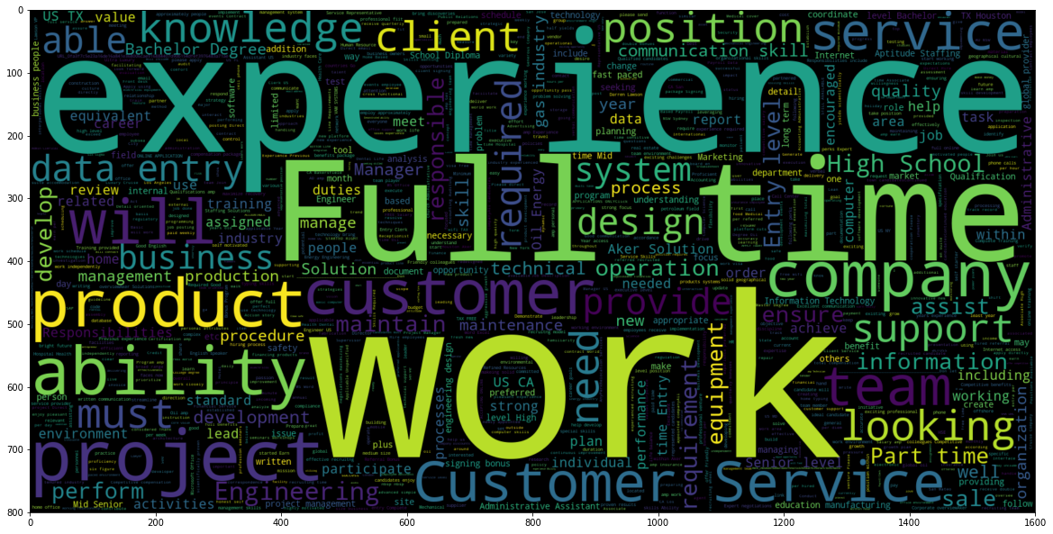
Fake Jobs DataFrame Words

Slide 35
Let us see the word frequency after doing some modifications like removing stop words, making the words in lower case, etc.

Slide 36
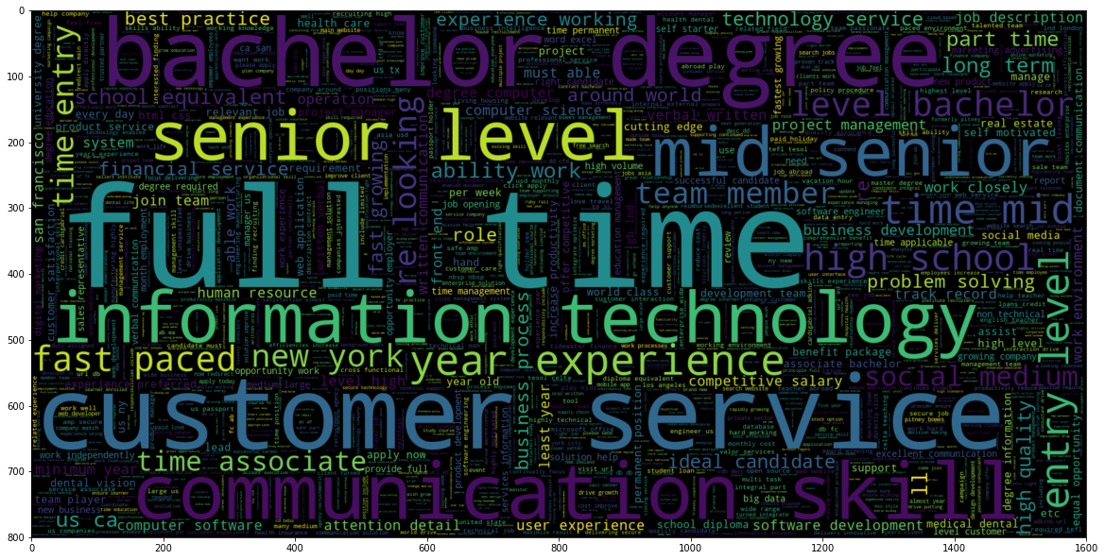
Original DataFrame Words after Modifications

Slide 37
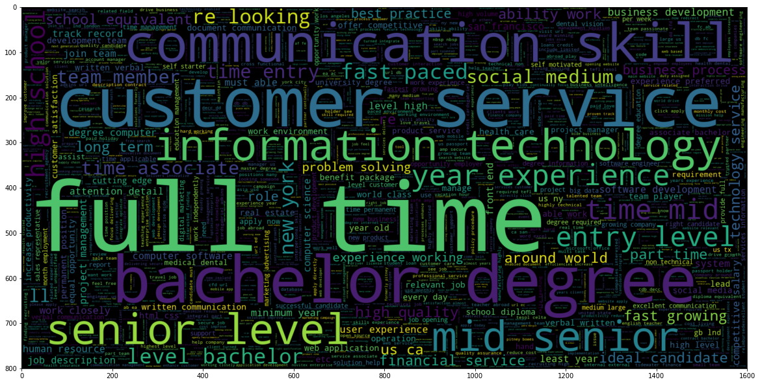
Real Jobs DataFrame Words after Modifications

Slide 38
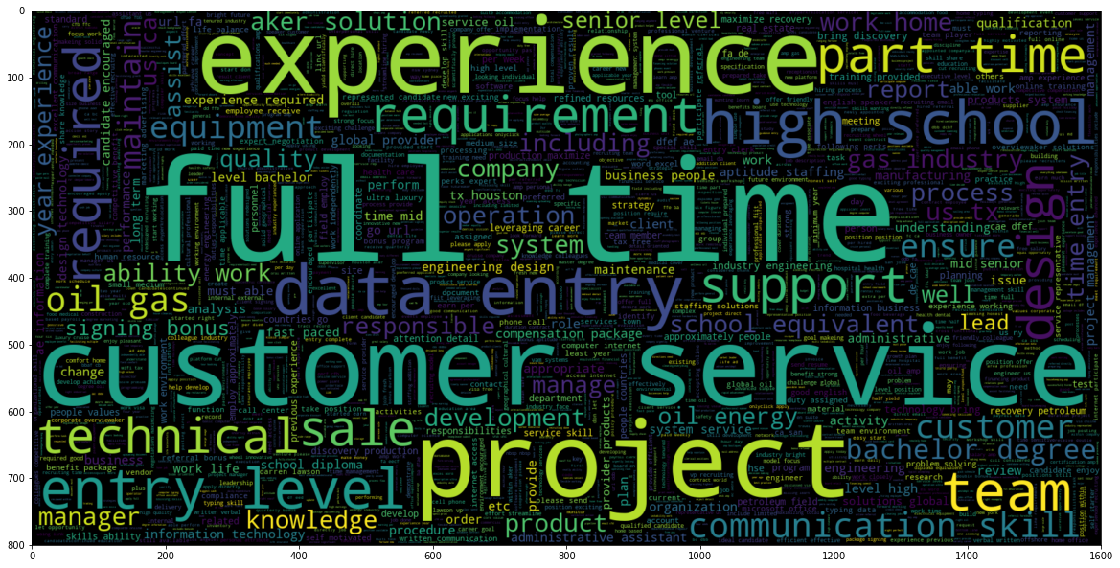
Fake Jobs DataFrame Words after Modifications

Slide 39
Tokenization:
Converted string into token of words

Slide 40
Removing Stop words:
Removed stop words from the token of words
['i', 'me', 'my', 'myself', 'we', 'our', 'ours', 'ourselves', 'you', "you're", "you've", "you'll", "you'd", 'your', 'yours', 'yourself', 'yourselves', 'he', 'him', 'his', 'himself', 'she', "she's", 'her', 'hers', 'herself', 'it', "it's", 'its', 'itself', 'they', 'them', 'their', 'theirs', 'themselves', 'what', 'which', 'who', 'whom', 'this', 'that', "that'll", 'these', 'those', 'am', 'is', 'are', 'was', 'were', 'be', 'been', 'being', 'have', 'has', 'had', 'having', 'do', 'does', 'did', 'doing', 'a', 'an', 'the', 'and', 'but', 'if', 'or', 'because', 'as', 'until', 'while', 'of', 'at', 'by', 'for', 'with', 'about', 'against', 'between', 'into', 'through', 'during', 'before', 'after', 'above', 'below', 'to', 'from', 'up', 'down', 'in', 'out', 'on', 'off', 'over', 'under', 'again', 'further', 'then', 'once', 'here', 'there', 'when', 'where', 'why', 'how', 'all', 'any', 'both', 'each', 'few', 'more', 'most', 'other', 'some', 'such', 'no', 'nor', 'not', 'only', 'own', 'same', 'so', 'than', 'too', 'very', 's', 't', 'can', 'will', 'just', 'don', "don't", 'should', "should've", 'now', 'd', 'll', 'm', 'o', 're', 've', 'y', 'ain', 'aren', "aren't", 'couldn', "couldn't", 'didn', "didn't", 'doesn', "doesn't", 'hadn', "hadn't", 'hasn', "hasn't", 'haven', "haven't", 'isn', "isn't", 'ma', 'mightn', "mightn't", 'mustn', "mustn't", 'needn', "needn't", 'shan', "shan't", 'shouldn', "shouldn't", 'wasn', "wasn't", 'weren', "weren't", 'won', "won't", 'wouldn', "wouldn't"]

Slide 41
Removing Punctuation marks:
Removed punctuation marks from the token of words
!"#$%&\'()*+,-./:;<=>?@[\\]^_`{|}~

Slide 42
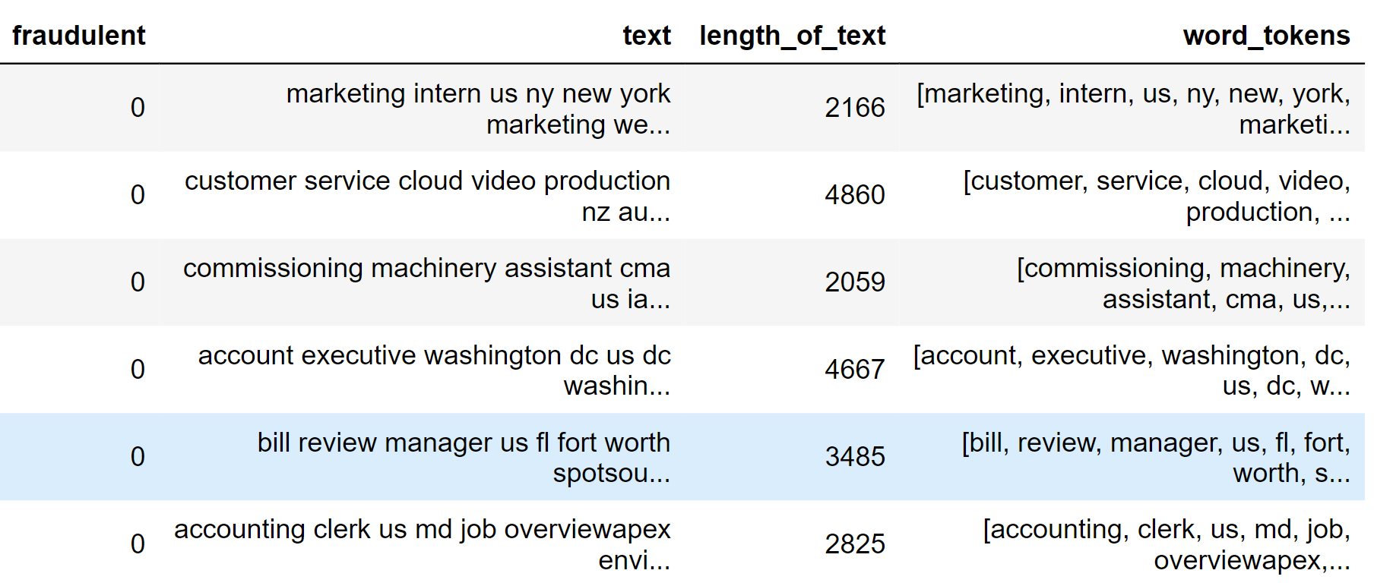

Slide 43
Stemming:
Porter Stemmer
Lancaster Stemmer
SnowBall Stemmer
Lemmetizar:
WordNet Lemmetizer ~~~> English wordnet

Slide 44
Word
celebrate
give
everything
editorial
business
using
technology
highly
Porter Stemmer
celebr
give
everyth
editori
busi
use
technolog
highli
Lancaster Stemmer
celebr
giv
everyth
edit
busy
us
technolog
high
SnowBall Stemmer
celebr
give
everyth
editori
busi
use
technolog
high
Wordnet Lemmetizer
celebrate
give
everything
editorial
business
using
technology
highly

Slide 45
CountVectorizer:
CountVectorizer is used to convert a collection of text documents to a vector of term/token counts.

Slide 46
Unigram, Bigram, …………………….., ngram:
We have implemented the concept of unigram, bigram and trigram in our project.

Slide 47
TF-IDF:
Term Frequency – Inverse Document Frequency
TF-IDF is a statistical measure that evaluates how relevant a word is to a document in a collection of documents.

Slide 48
Multinomial NB:
Multinomial Naive Bayes
The multinomial Naive Bayes classifier is suitable for classification with discrete features (e.g., word counts for text classification). The multinomial distribution normally requires integer feature counts. However, in practice, fractional counts such as tf-idf may also work.
~ Reference:
sklearn.naive_bayes.MultinomialNB document

Slide 49
Accuracy
Accuracy using MultinomialNB: 0.9680

Slide 50
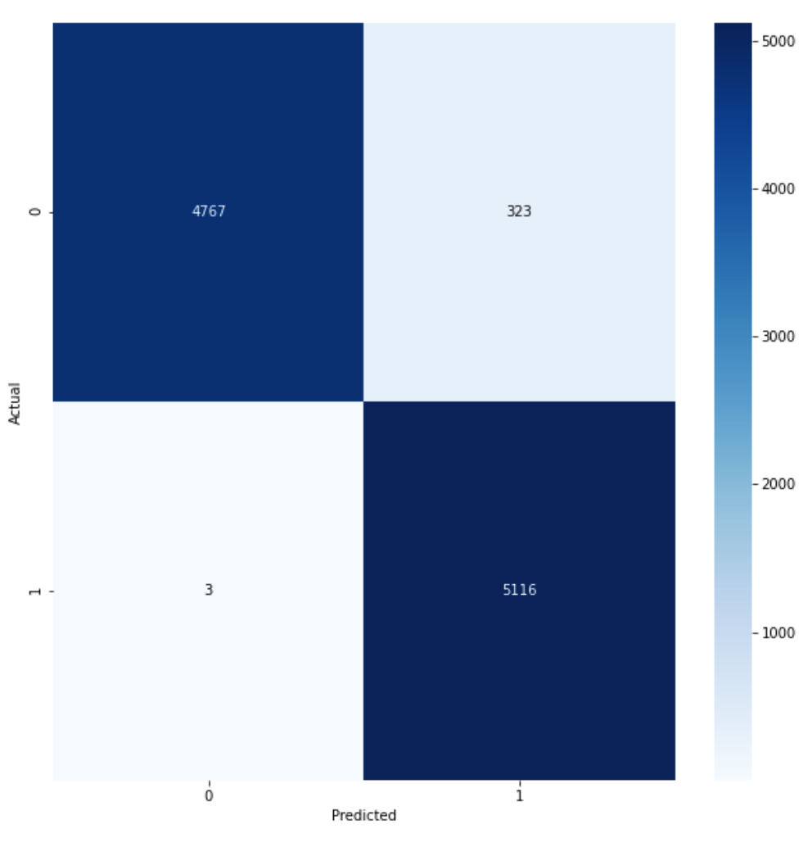
CONFUSION MATRIX

Slide 51
Further Work:
Trying different models and comparing the accuracy among these models

Slide 52
References:
Ion Androutsopoulos, Georgios Paliouras, Vangelis Karkaletsis, Georgios Sakkis, Constantine D. Spyropoulos, and Panagiotis Stamatopoulos. 2000. Learning to filter spam e-mail: A comparison of a naive bayesian and a memory-based approach. CoRR, cs.CL/0009009.
Shawni Dutta and Samir Kumar Bandyopadhyay. 2020. Fake job recruitment detection using machine learning approach. International Journal of Engineering Trends and Technology, 68(4):48–53.
Ibrahim M. Nasser and Amjad H. Alzaanin. 2020. Machine learning and job posting classification: A comparative study. International Journal of Engineering and Information Systems (IJEAIS), 4(9):06–14.
J. C. S. Reis, A. Correia, F. Murai, A. Veloso, and F. Benevenuto. 2019. Supervised learning for fake news detection. IEEE Intelligent Systems, 34(2):76–81.

Slide 53


